Slide 1


Charlotte Bailey
16th March 2024

Slide 2

Outline
Executive Summary
Introduction
Methodology
Results
Conclusion
Appendix

Slide 3
Executive Summary
Summary of Methodologies
Data collection (Via API and Web Scraping)
Data wrangling
Exploratory data analysis (EDA)
Interactive map with Folium
Dashboards with Plotly Dash
Predictive analysis
Summary of all results
Exploratory data analysis (EDA) results
Interactive map and dashboard
Predictive analysis models and results

Slide 4
Introduction
Project background and context
The aim of this project is to ultimately predict whether the Space X Falcon 9 first stage will successfully land.
The Space X website states that the launch cost of the Falcon 9 was 62 million dollars whilst other providers usually cost upwards of 165 million dollars. This considerable difference in cost is due to Space X being able to land and then re-use the first stage of the rocket.
If we are therefore able to predict whether the first stage will successfully land then we are able to determine the launch cost. These results provide valuable information for companies who want to bid against Space X for a rocket launch.
Problems you want to find answers
The main factors contributing to a successful and unsuccessful landing.
The effect of each relationship of the rocket variables on a successful and unsuccessful landing.
The optimal conditions to achieve the best landing success.

Slide 5

Section 1

Slide 6
Methodology
Executive Summary
Data collection methodology:
Via SpaceX REST API
Web scrapping through Wikipedia
Perform data wrangling
One Hot Encoding for classification models
Dropping irrelevant columns
Perform exploratory data analysis (EDA) using visualization and SQL
Perform interactive visual analytics using Folium and Plotly Dash
Perform predictive analysis using classification models
Building, tuning and evaluating classification models

Slide 7
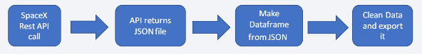

Data Collection
Datasets were collected from REST Space X API and by Web Scrapping Wikipedia.
The information that was acquired by the API were rocket, launches and payload information.
SpaceX REST API URL: https://api.spacexdata.com/v4/launches/past
The information that was acquired through Web Scapping Wikipedia were launches, landing and payload information.
Wikipedia URL: https://en.wikipedia.org/w/index.php?title=list_of_Falcon_Heavy_launches&oldid=1027686922

Slide 8
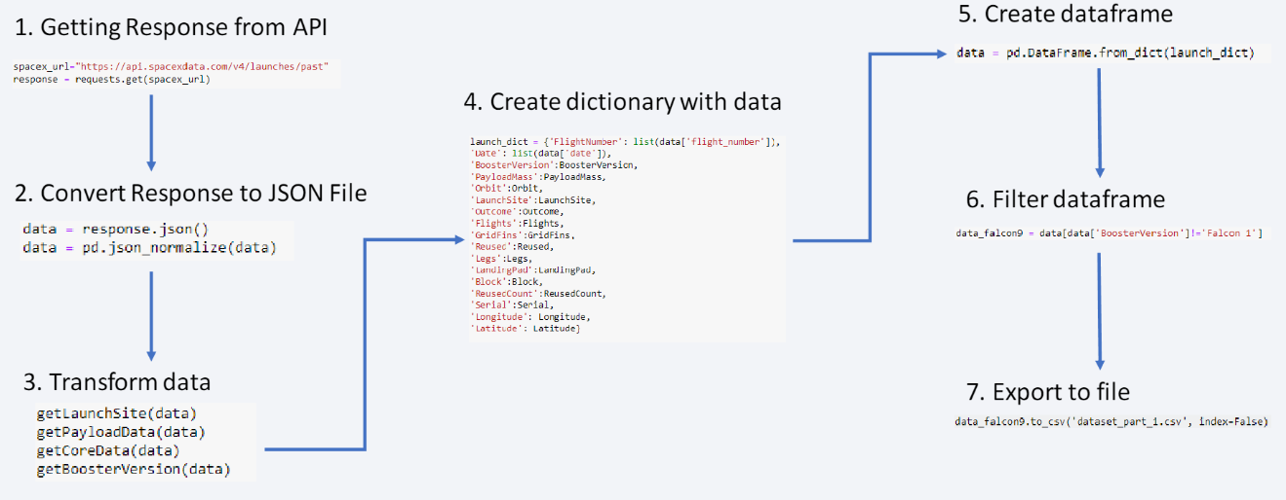
Data Collection – SpaceX API

Slide 9
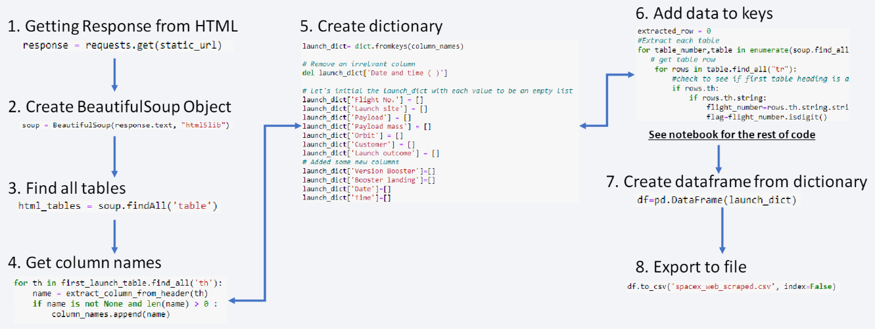
Data Collection - Scraping

Slide 10
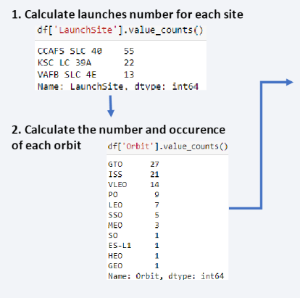
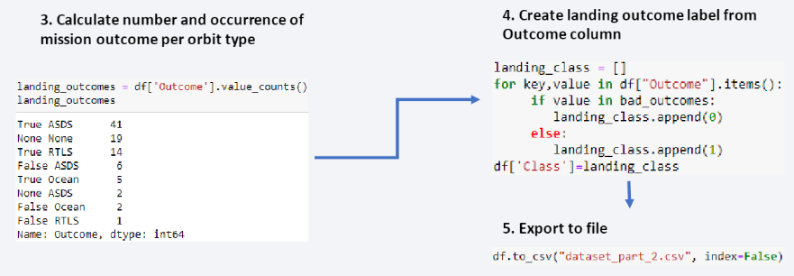
Data Wrangling
The dataset shows several examples of the booster not landing successfully. True Ocean, True RTLS, True ASDS means the mission was successful. False Ocean, False RTLS, False ASDS means the mission was not successful.
String variables need to be transformed into categorical variables. 1 means successful mission and 0 means unsuccessful.

Slide 11
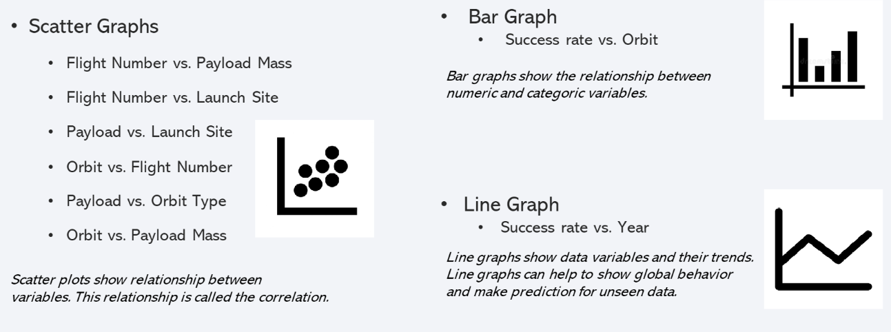

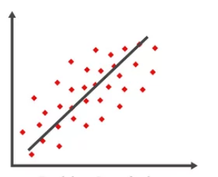
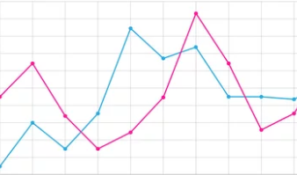
EDA with Data Visualization

Slide 12
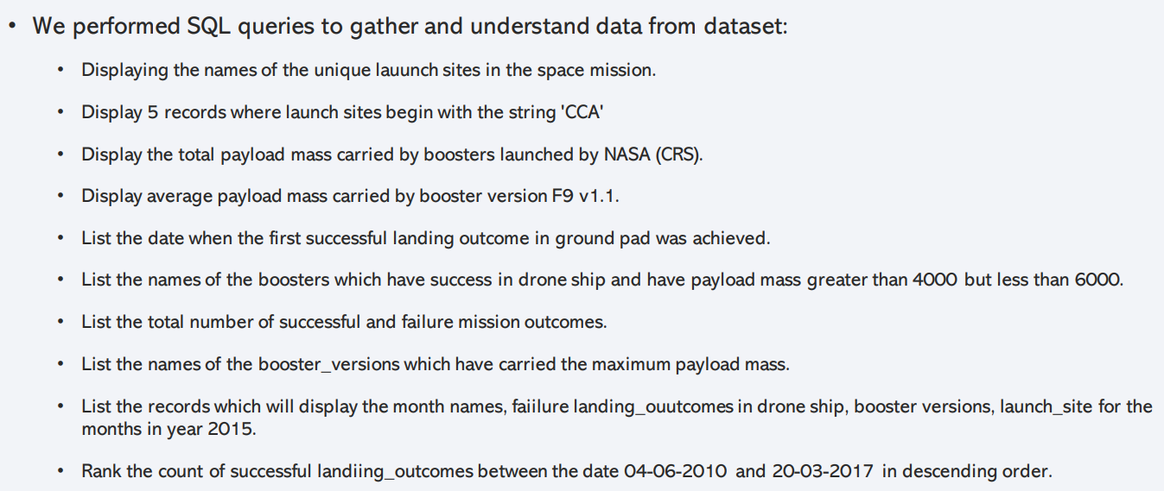
EDA with SQL

Slide 13
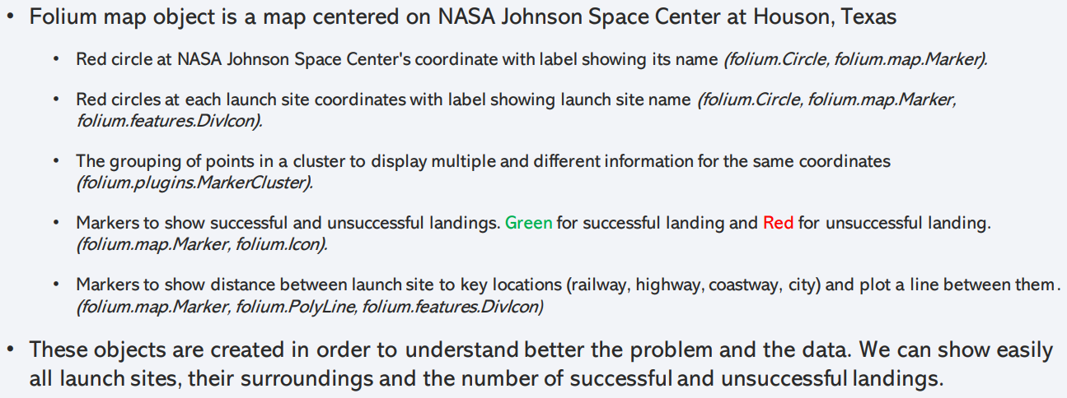
Build an Interactive Map with Folium

Slide 14
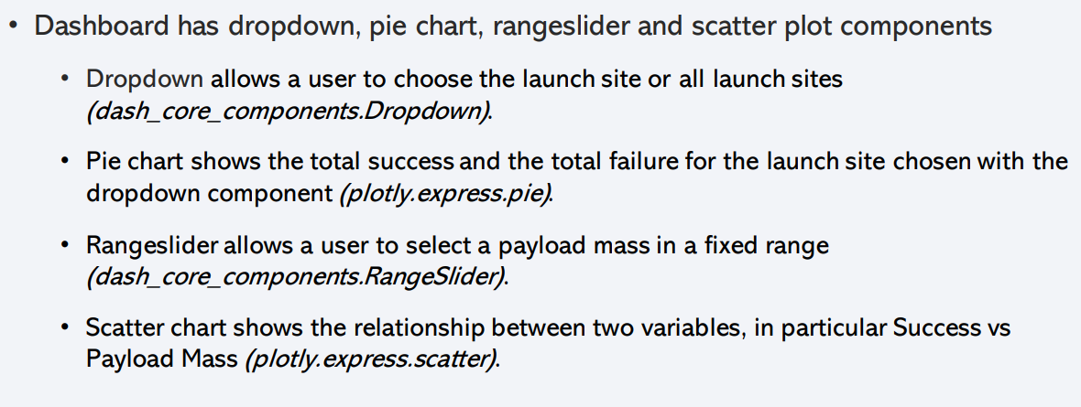
Build a Dashboard with Plotly Dash

Slide 15
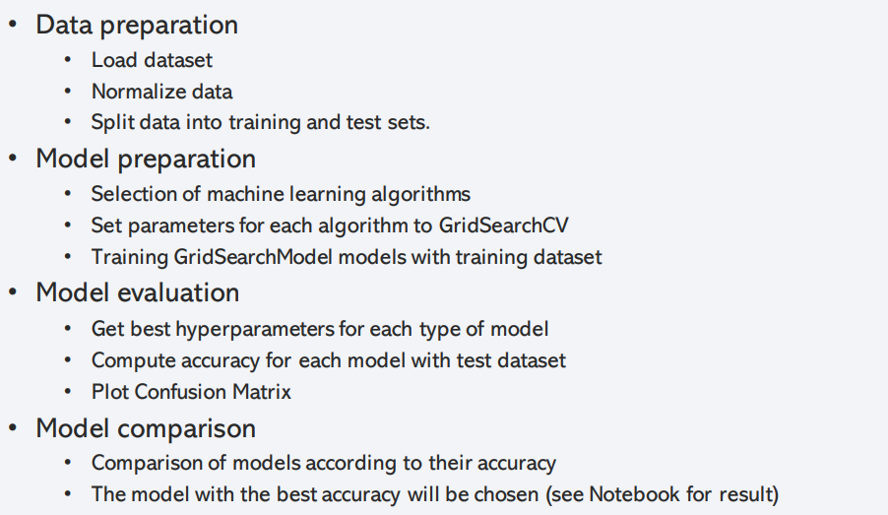
Predictive Analysis (Classification)

Slide 16
Results
Exploratory data analysis results
Interactive analytics demo in screenshots
Predictive analysis results

Slide 17

Section 2

Slide 18
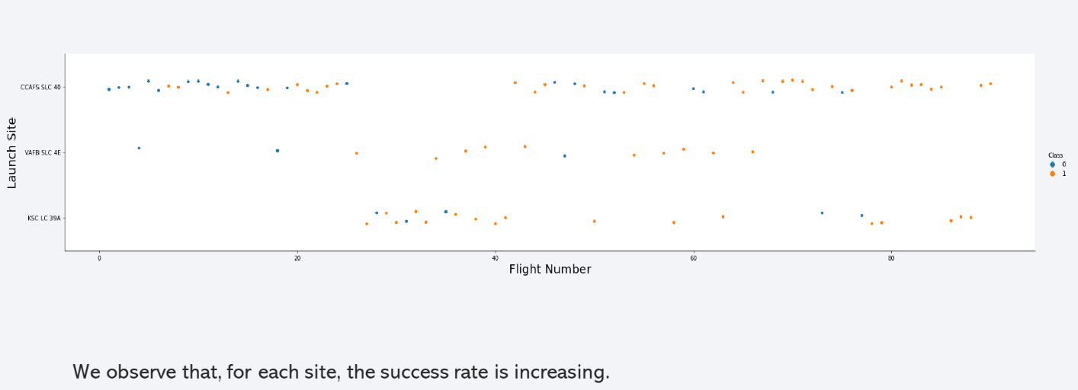
Flight Number vs. Launch Site

Slide 19
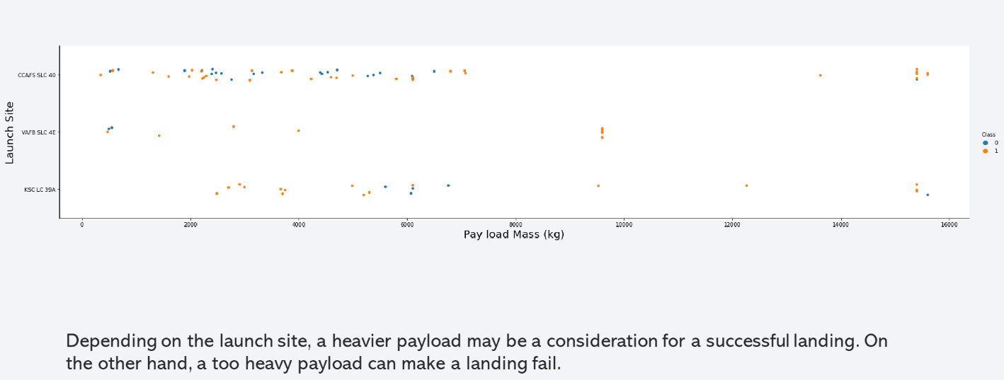
Payload vs. Launch Site

Slide 20
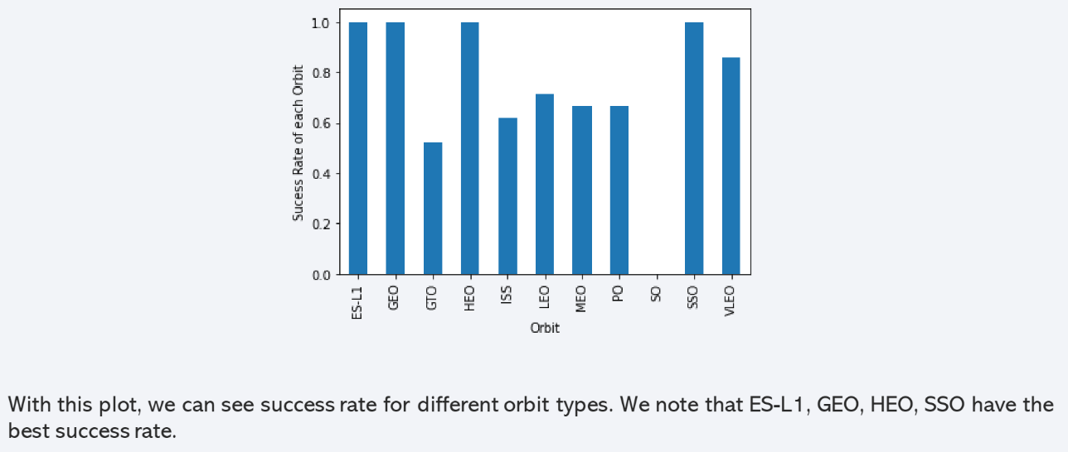
Success Rate vs. Orbit Type

Slide 21
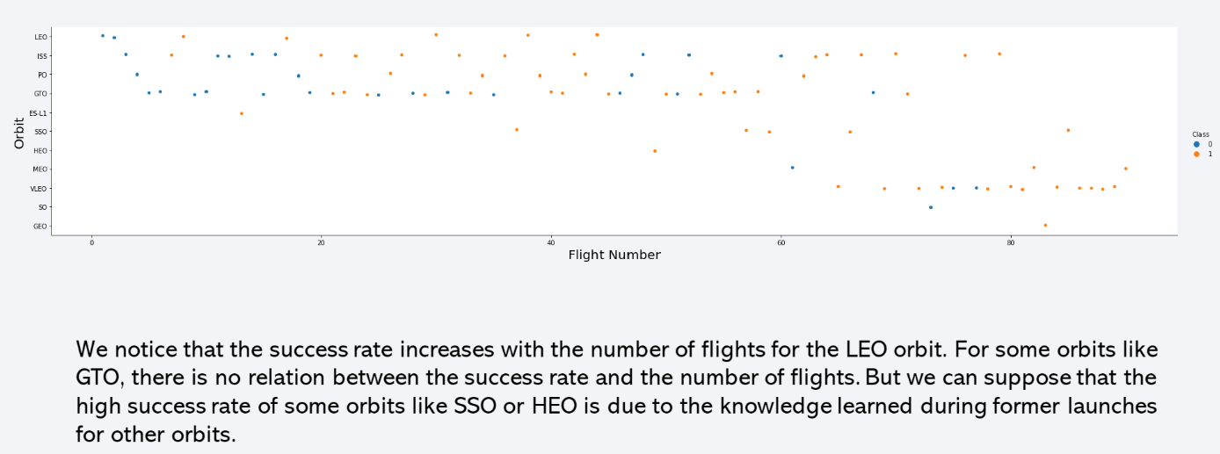
Flight Number vs. Orbit Type

Slide 22
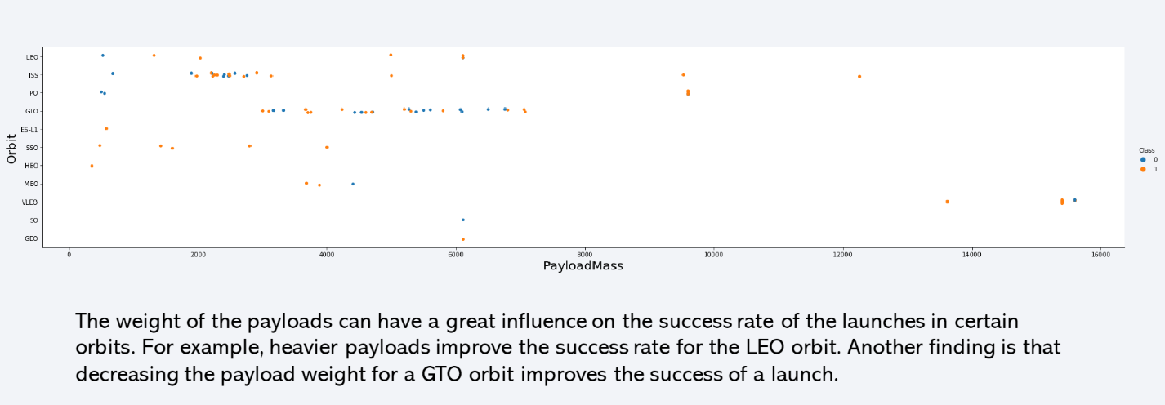
Payload vs. Orbit Type

Slide 23
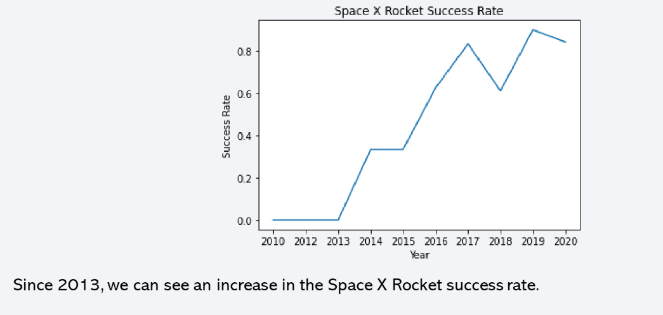
Launch Success Yearly Trend

Slide 24
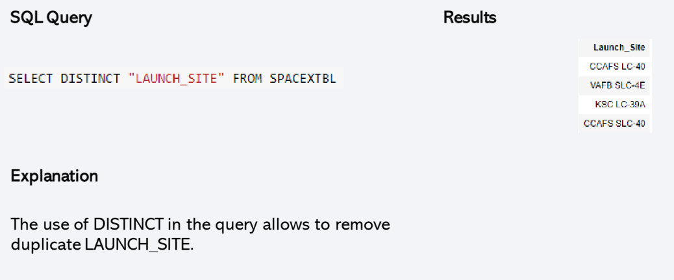
All Launch Site Names

Slide 25
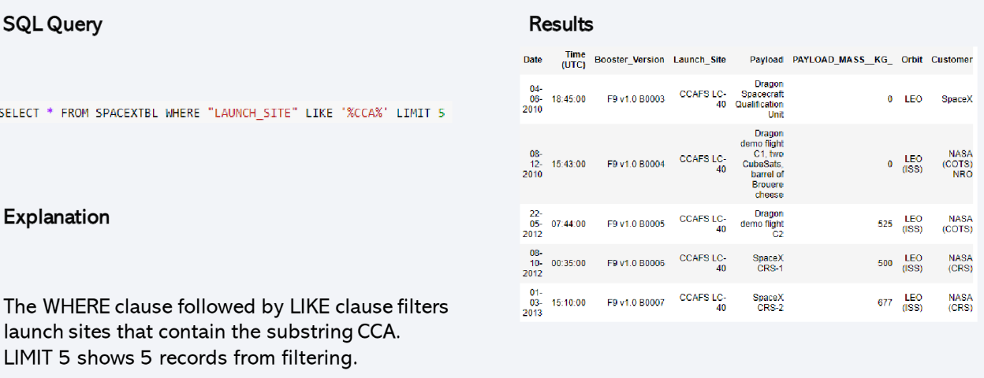
Launch Site Names Begin with 'CCA'

Slide 26
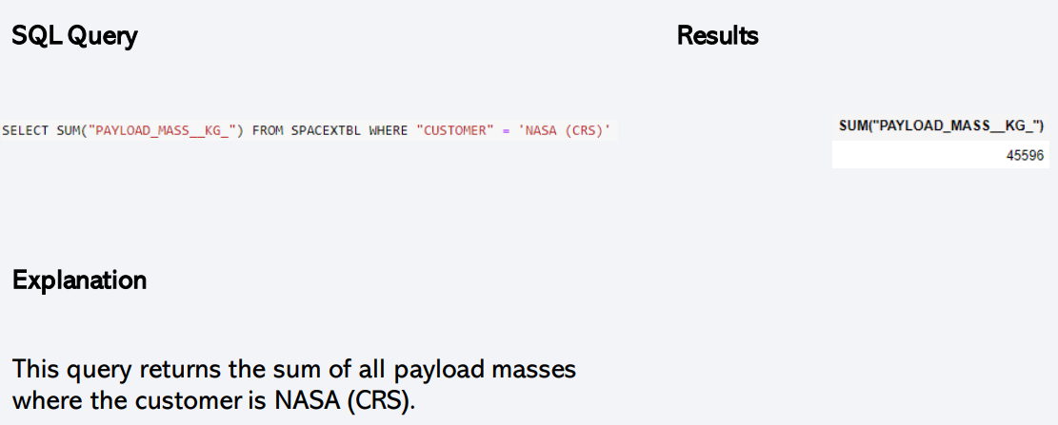
Total Payload Mass

Slide 27
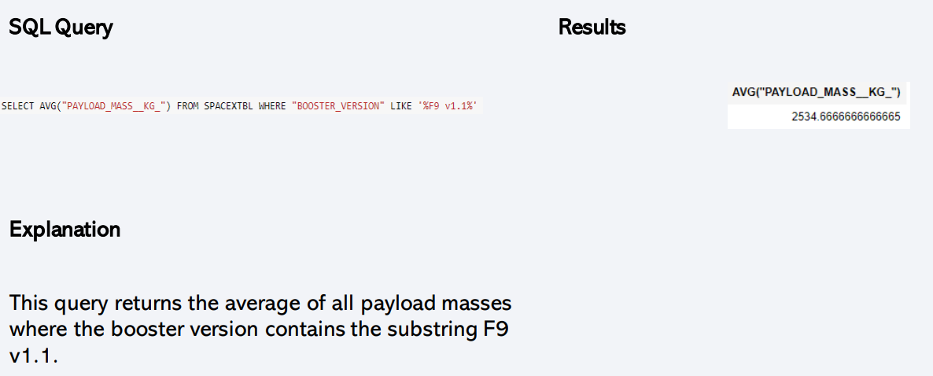
Average Payload Mass by F9 v1.1
Calculate the average payload mass carried by booster version F9 v1.1
Present your query result with a short explanation here

Slide 28
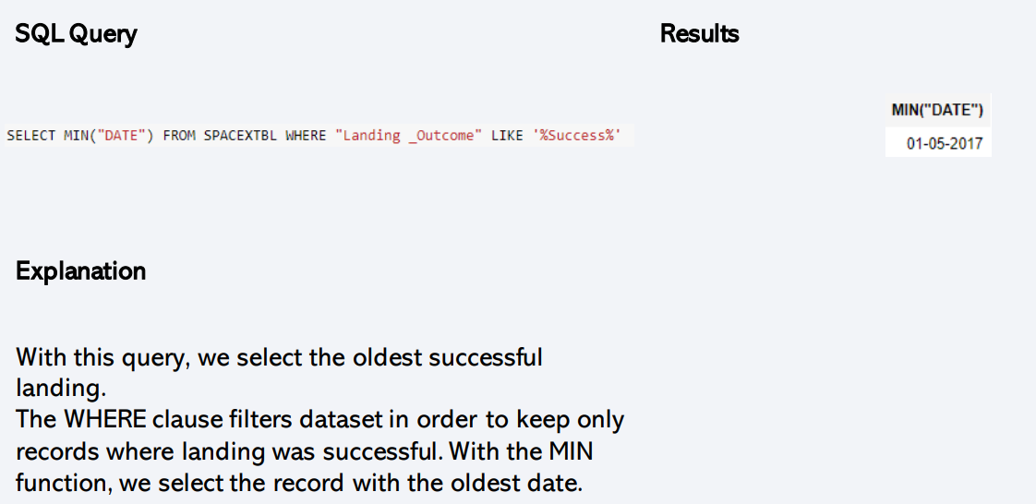
First Successful Ground Landing Date

Slide 29
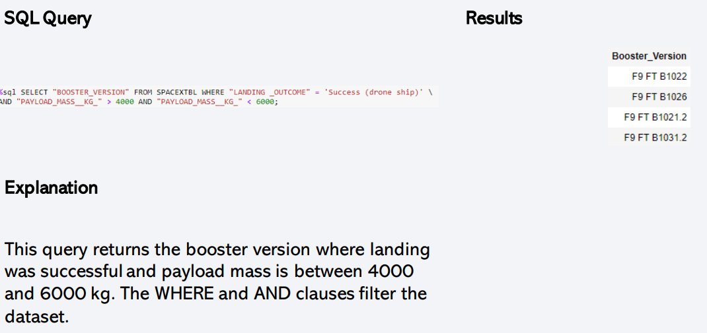
Successful Drone Ship Landing with Payload between 4000 and 6000

Slide 30
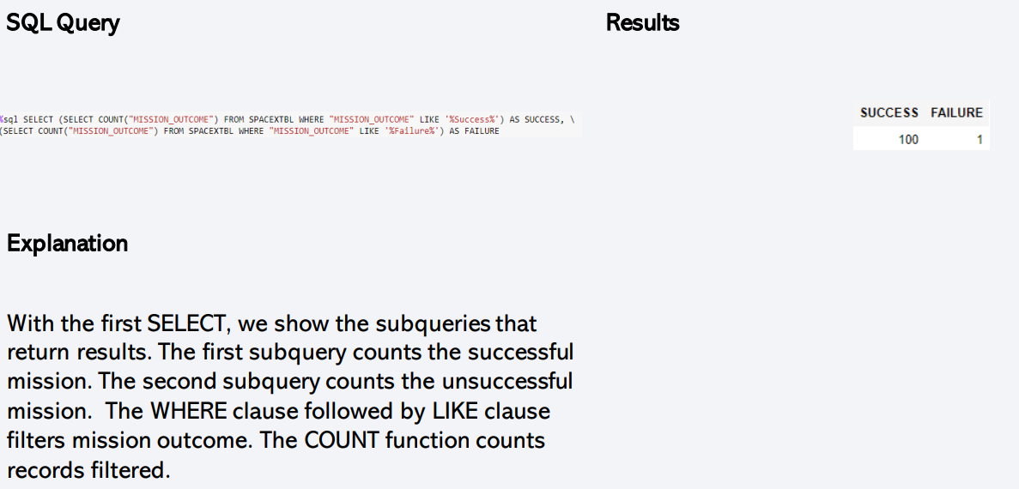
Total Number of Successful and Failure Mission Outcomes

Slide 31
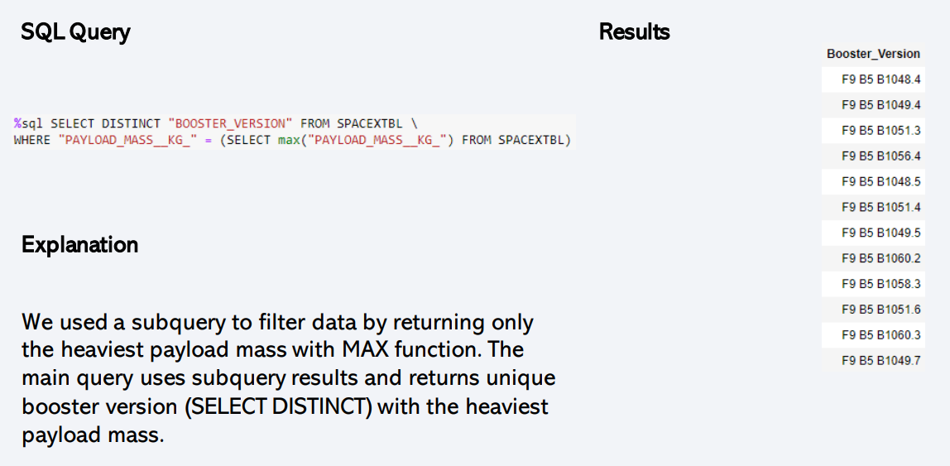
Boosters Carried Maximum Payload

Slide 32
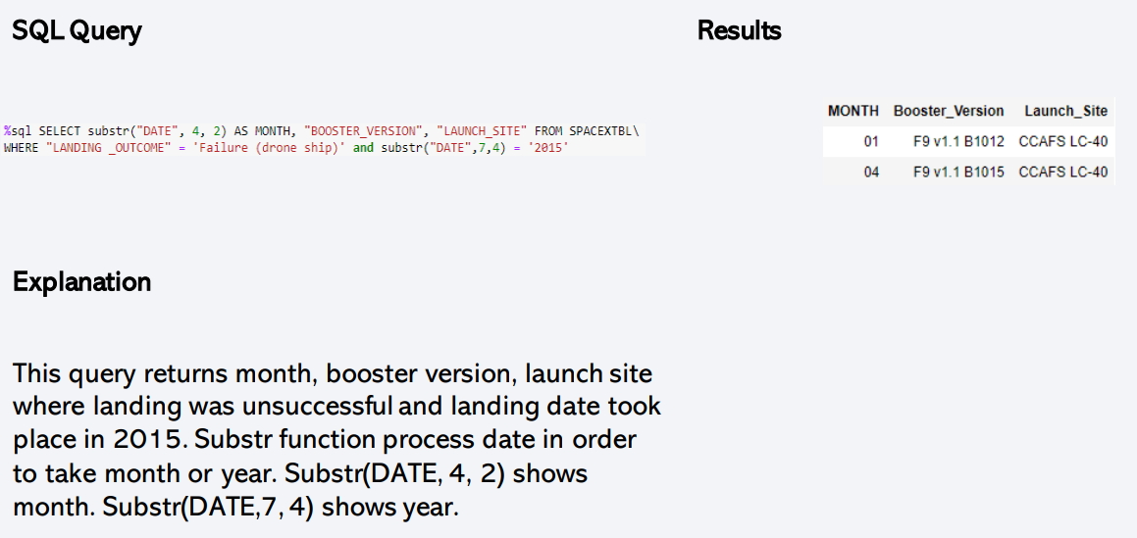
2015 Launch Records

Slide 33
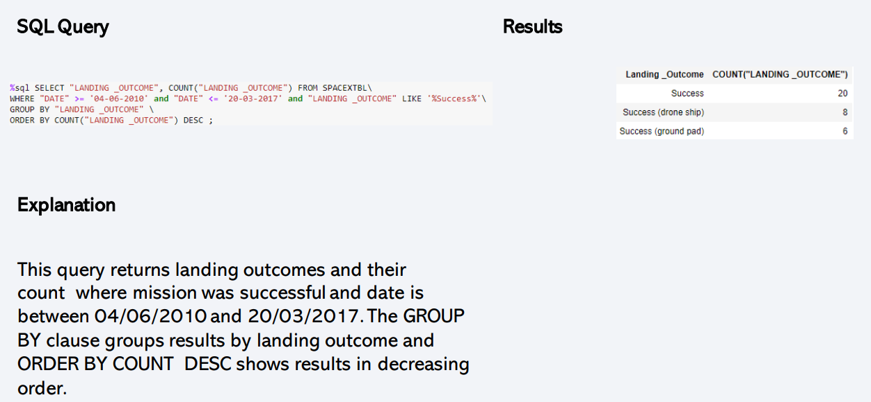
Rank Landing Outcomes Between 2010-06-04 and 2017-03-20

Slide 34

Section 3

Slide 35
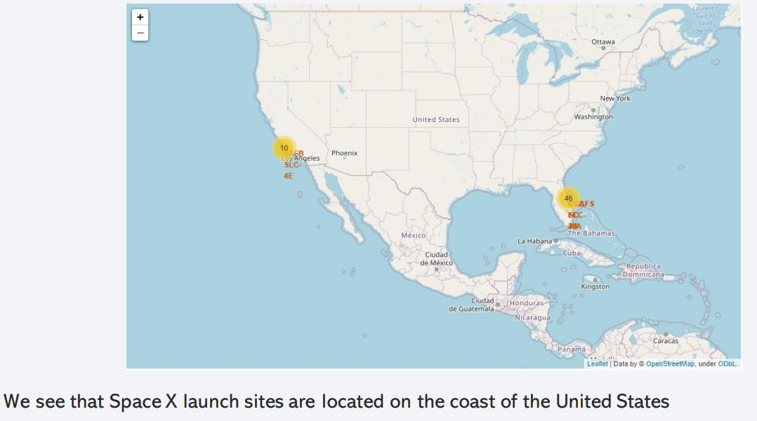
Folium Map – Ground Stations

Slide 36
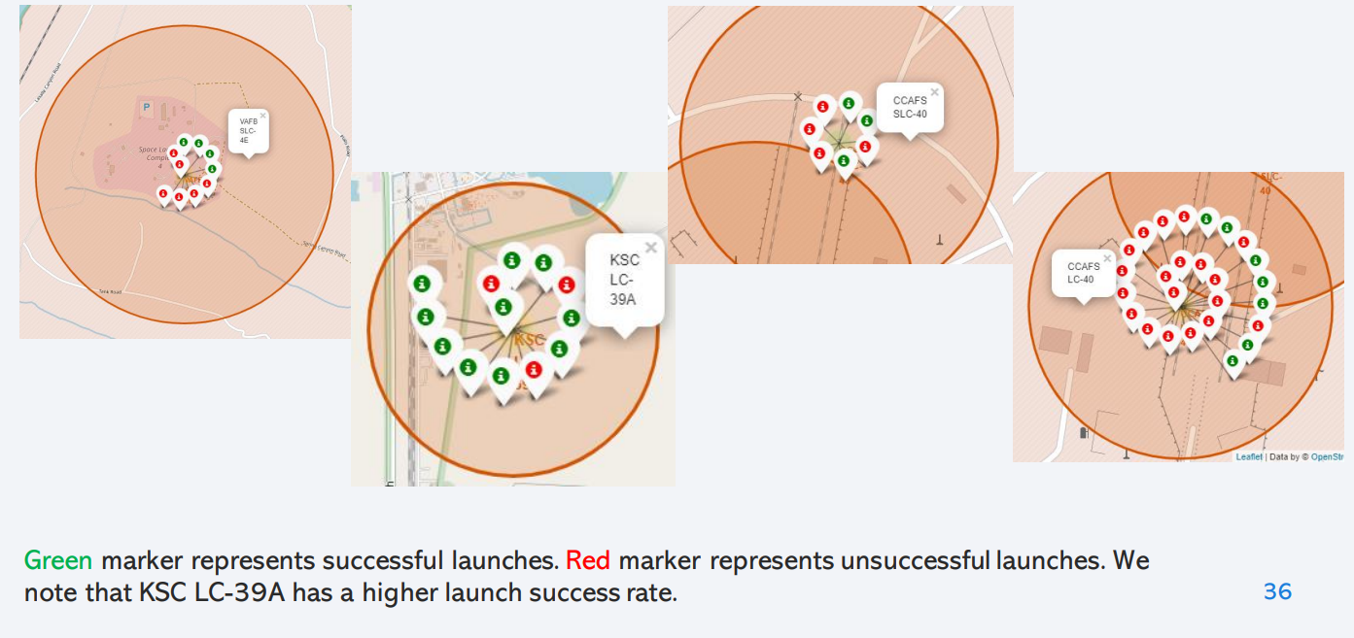
Folium Map – Colour labelled markers
Replace <Folium map screenshot 2> title with an appropriate title
Explore the folium map and make a proper screenshot to show the color-labeled launch outcomes on the map
Explain the important elements and findings on the screenshot

Slide 37
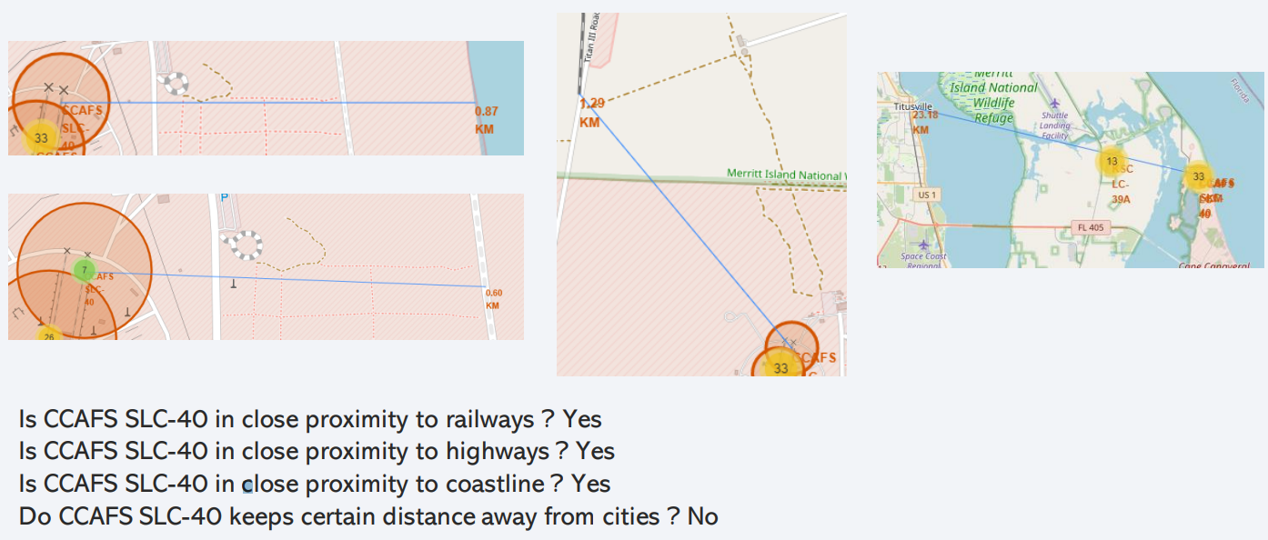
Folium Map – Distances between CCAFS SLC40 and its proximities

Slide 38

Section 4

Slide 39
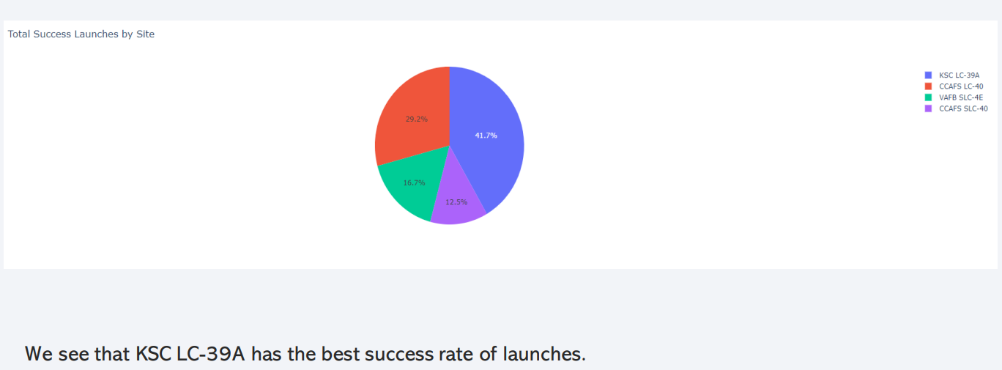
Dashboard – Total success by site

Slide 40
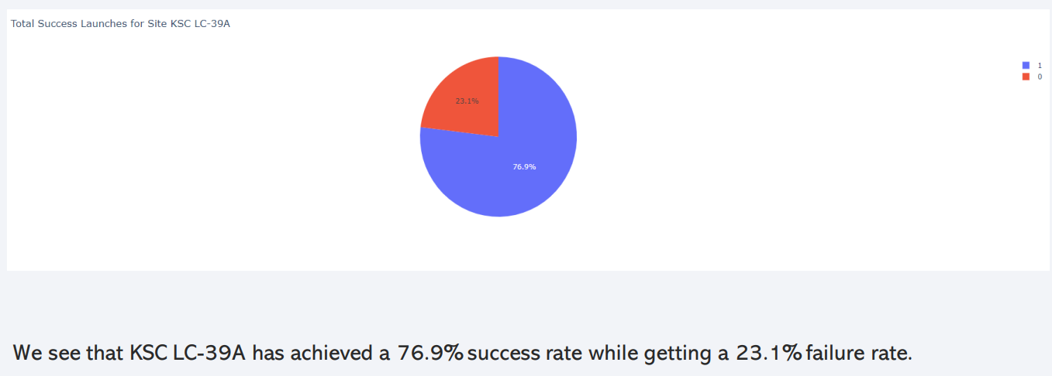
Dashboard – Total success launches for site KSC LC-39A

Slide 41
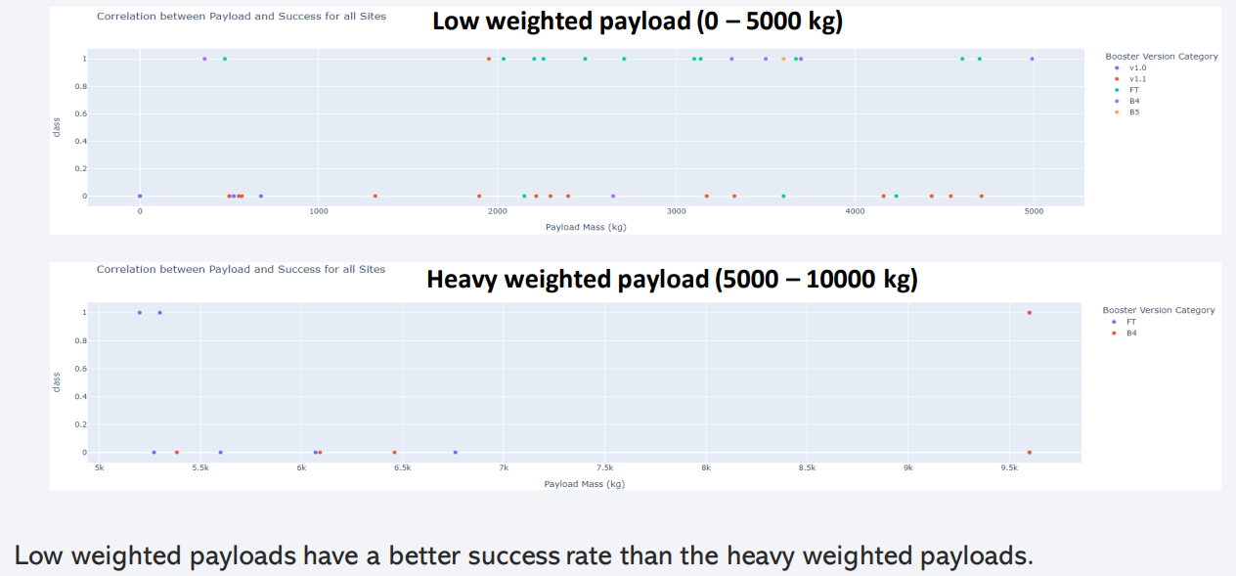
Dashboard – Payload mass vs Outcome for all sites with difference payload mass selected

Slide 42

Section 5

Slide 43
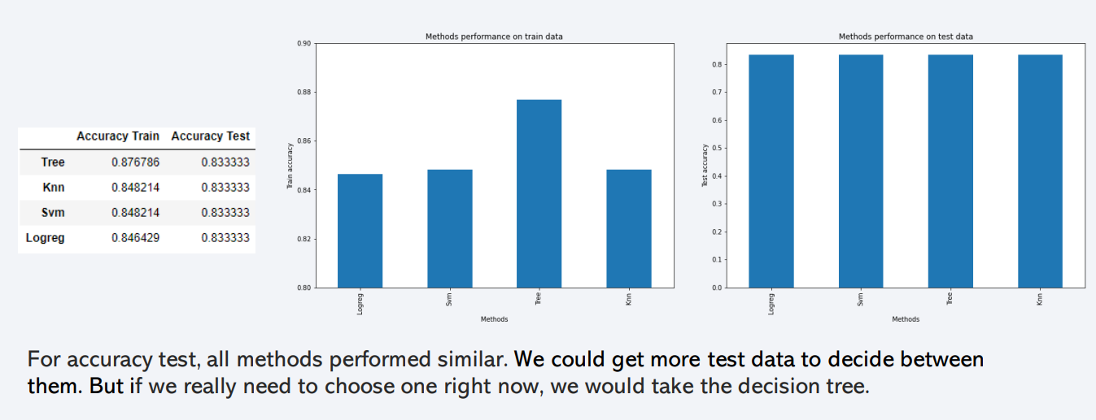
Classification Accuracy

Slide 44
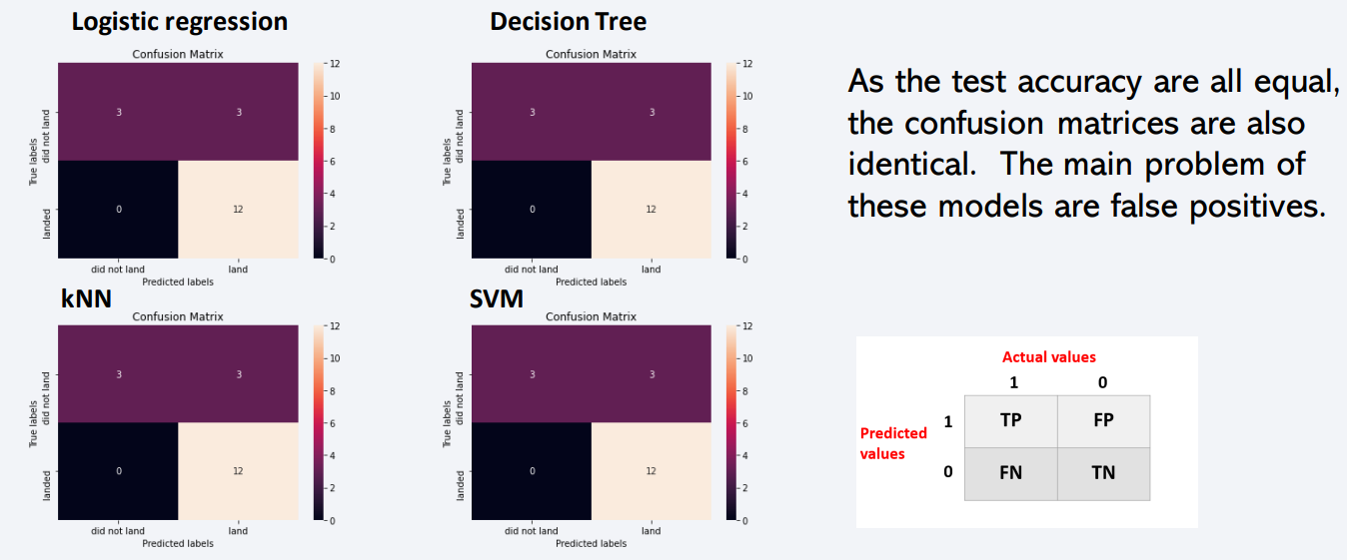
Confusion Matrix
Show the confusion matrix of the best performing model with an explanation

Slide 45
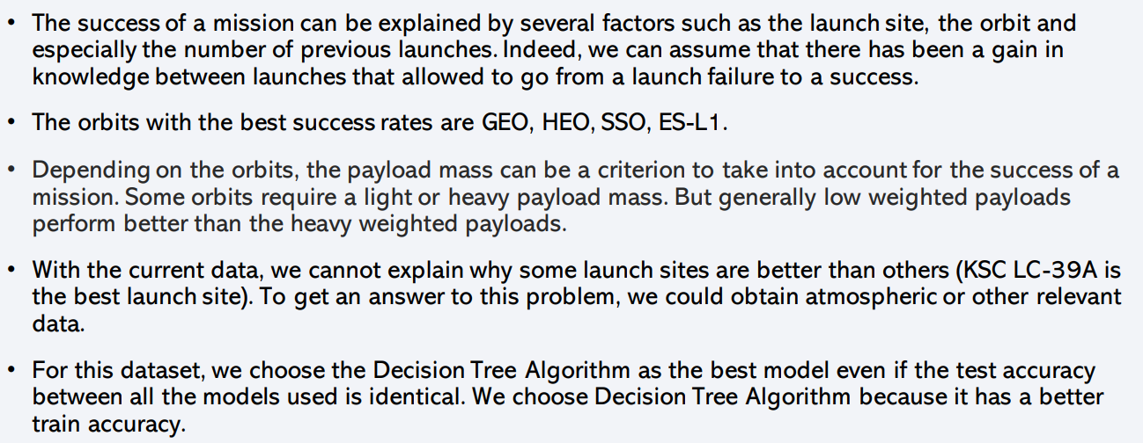
Conclusions

Slide 46


